Slide 1
MLOps final
Team 6
Mucong Li, Yang Liu, Junrui Wan, Linghao Yang

Slide 2
Agenda
Context & Data
Business Problem
Platform Comparison
Choice of Platform
Challenges
Future Improvement

Slide 3
Context & Data
We are currently experiencing the great resignation.
10.9 million open jobs at the end of July
Cost of turnover is 1.5 ~ 2 times the employee’s salary
Data-driven approach for:
Why
Who
How
Data: IBM HR Analytics Employee Attrition & Performance dataset from Kaggle.
Notes:
CONTEXT
We are currently experiencing the great resignation.
According to the U.S. Bureau of Labor Statistics, 4 million Americans quit their jobs in July 2021. Resignations peaked in April and have remained abnormally high for the last several months, with a record-breaking 10.9 million open jobs at the end of July.
In addition, The cost of turnover is extremely high; it’s estimated that losing an employee can cost 1.5-2 times the employee’s salary.
Thus, it’s necessary for employers to take a data-driven approach to improve retention. Such approach can reveal:
why people are leaving
who has the highest turnover risk, and
help develop tailored retention programs.
DATA
For our purpose, we would like to build predictive models to predict attrition and make recommendations to the employer based on the result.
This data can help us uncover the factors that lead to employee attrition and explore important questions such as:
‘show me a breakdown of distance from home by job role and attrition’ or
‘compare average monthly income by education and attrition’.
PS - Data source: https://www.kaggle.com/pavansubhasht/ibm-hr-analytics-attrition-dataset

Slide 4
Business Problem
Importantly, we need a MLOps platform for:
Make predictions more frequently with real-time data updated daily as employees are most likely to resign when they have a new job offer
Monitor the model performance and make adjustment promptly as the drivers behind resignation are constantly changing.
Allow people team with no data science background to make analysis with no code
Notes:
Analyzing the employee data with predictive models is one of the most effective ways to combat the resignation issue. Importantly, we need a MLOps platform to put the model into production. A good platform can be used to accomplish two things:
Put the model into production so that it make predictions more frequently with real-time data updated daily. Since employees are most likely to resign when they have a new job offer, and the interview process may not take long, it’s crucial to make accurate predictions in a short period of time and provide incentives for employees to stay.
Monitor the model performance and make adjustment promptly. Since the drivers behind resignation are constantly changing, especially in a global pandemic where uncertainty is the only certainty, a good MLOps platform can help the employer and the people analytics team understand the changing dynamics of the job market and the needs of the employees.
Further, some platforms can operate with no code, which may suit the needs of people teams that do not have a data science background.

Slide 5
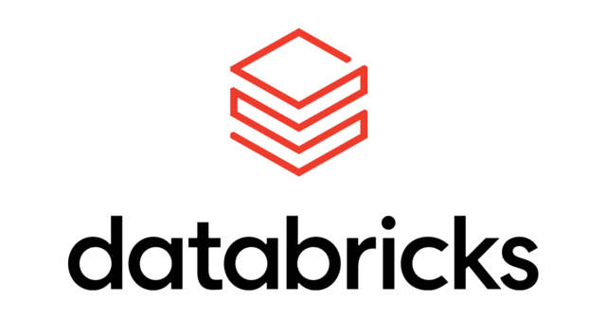

PLatform Comparison
Microsoft
Large market share
Computer, Mobile, Storage, Data Management…
The monthly Azure ML: $167
Apache Spark
10.11% in big-data-analytics market
Data Analytics Platform
The monthly price: $203
Notes:
https://www.extremetech.com/deals/307468-microsoft-azure-is-used-by-95-percent-of-fortune-500-companies-learn-to-use-their-cloud-services-now
https://databricks.com/product/azure-pricing
Is Used By 95 Percent Of Fortune 500 Companies
https://azure.microsoft.com/en-us/pricing/calculator/
reliable and scalable platform for your data pipelines, data lakes, and data platforms.
Standard / premium

Slide 6



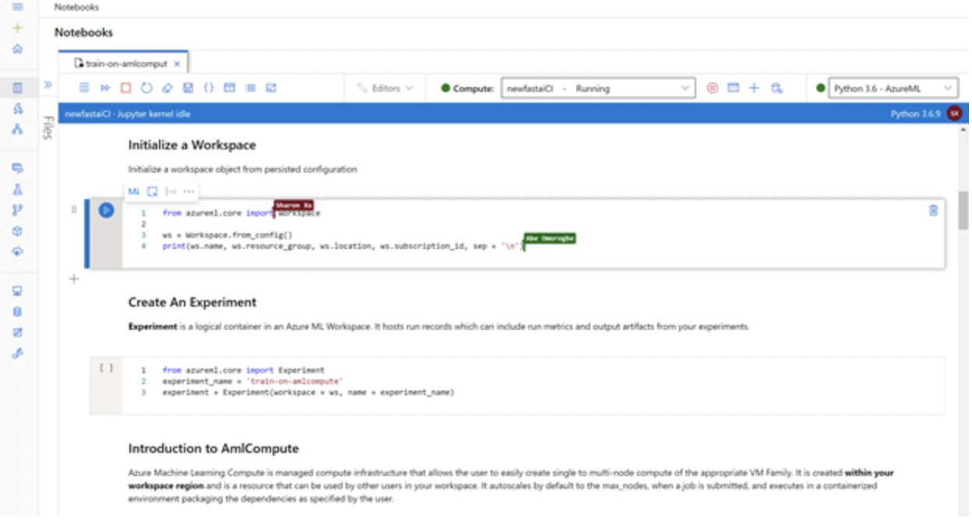
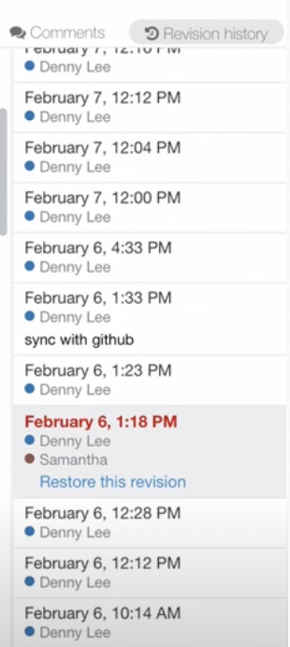
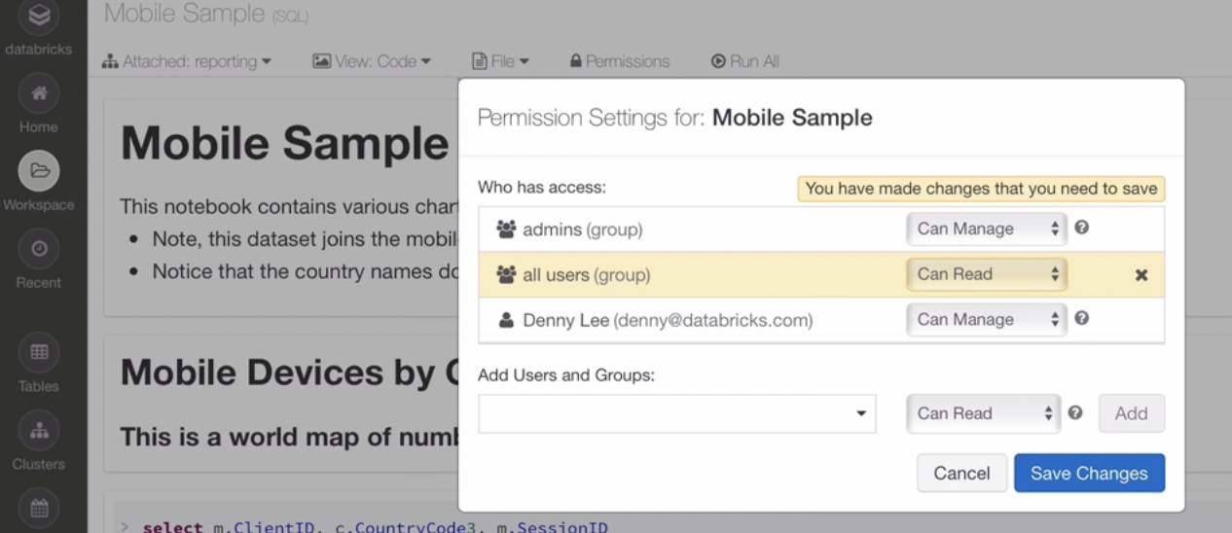
Collaboration
Add co-workers to workspace
Share files/comment/edit
History edit search
Add co-workers to notebook
Share files/comment/edit
History edit search
Notes:
Using the same workspace
Collaboration azure: like google colab work together
https://databricks.com/product/collaborative-notebooks
To share a Studio (classic) workspace
In the left panel, click SETTINGS.
Click the USERS tab.
Click INVITE MORE USERS at the bottom of the page.
Enter one or more email addresses. ...
Select whether you want to add the users as Owner or User.
Click the OK checkmark button.

Slide 7
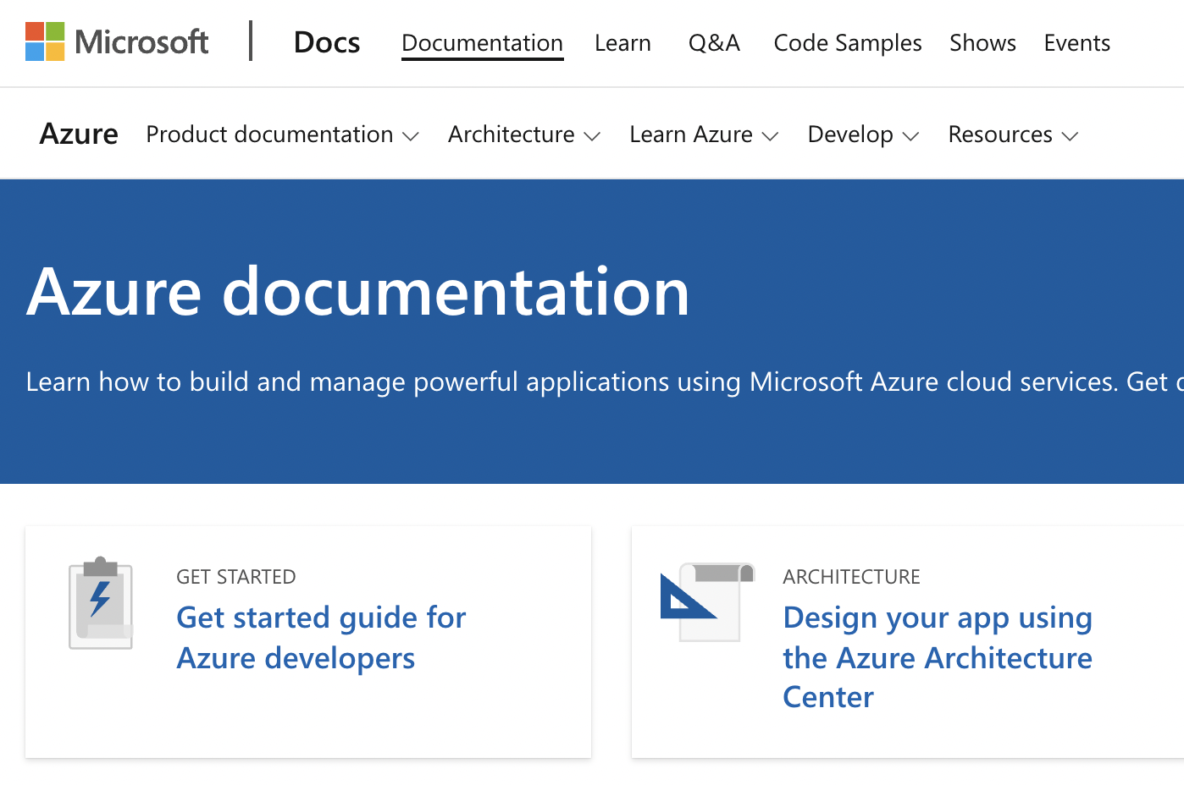
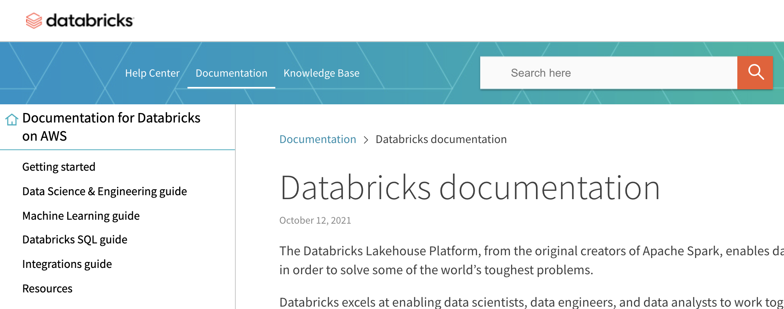
Support
1.Online document and community support
2.unlimited support tickets
3.Azure advisor - a free guide to best practices
1.online document and community support
2. Receive service response
3. Spark support technical experts for troubleshooting (2 hour /month)

Slide 8
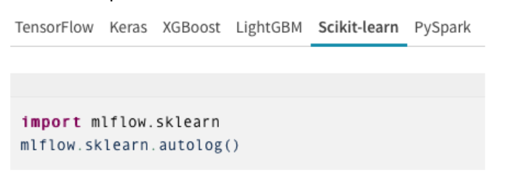
Pipeline
Code-MLflow
Code/Azure studio
Easier to reproduce experiments and compare results

Slide 9

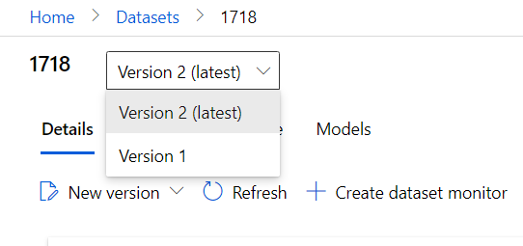
Data Versioning
Multiple versions of the same dataset
Retrieve specific versions later

Slide 10
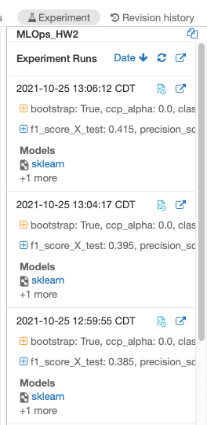
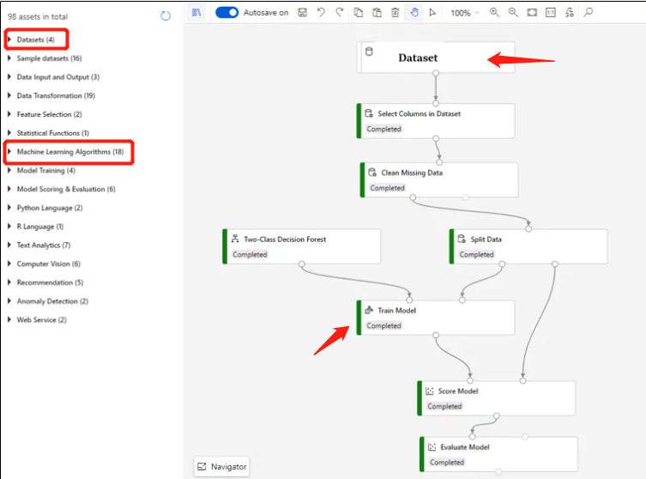
Continuous Training

Slide 11
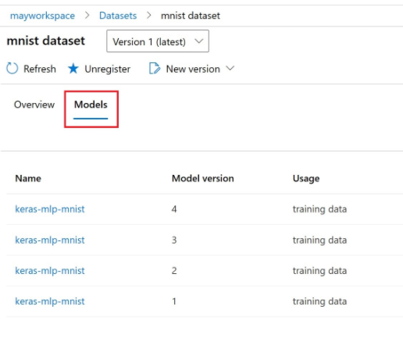
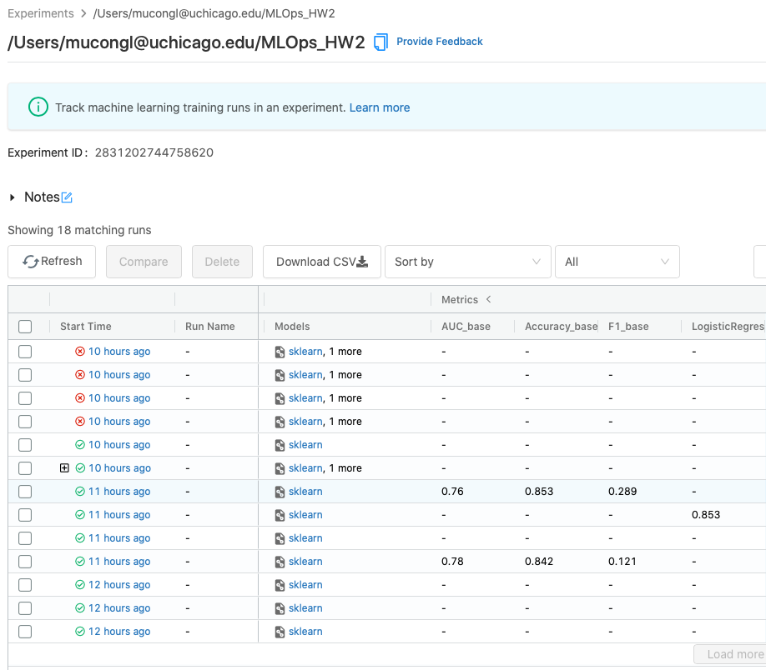
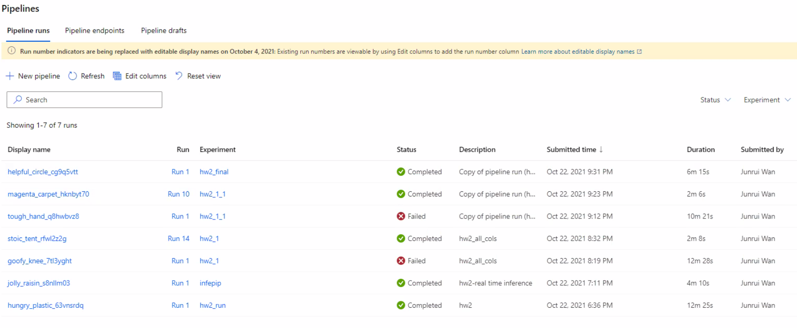
Model Versioning

Slide 12
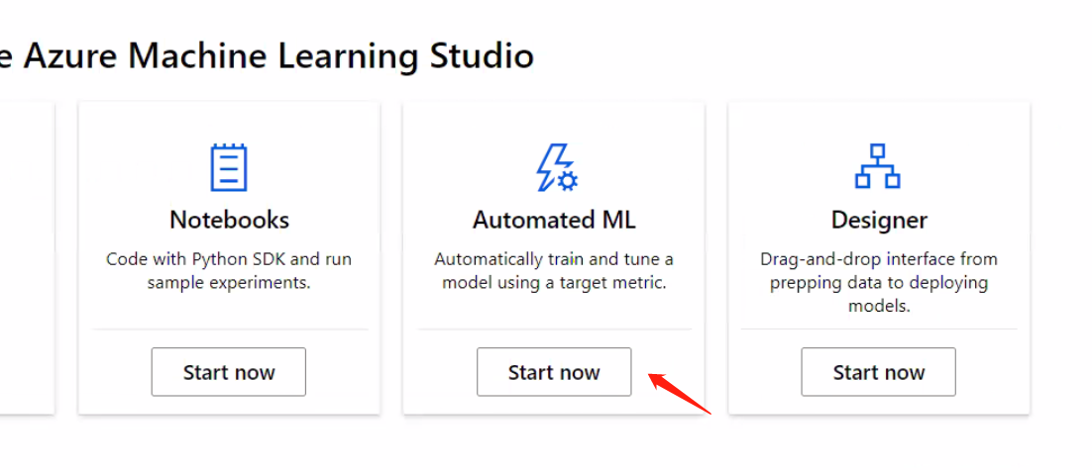
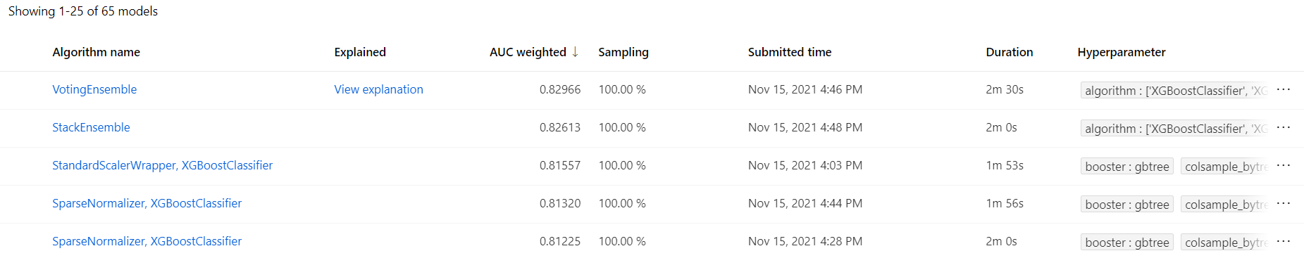
Auto ML

Slide 13
Testing
Ability of splitting into training and test dataset
Ability of comparing model performance by different metrics
Accuracy
Precision
Recall
F1
AUC

Slide 14
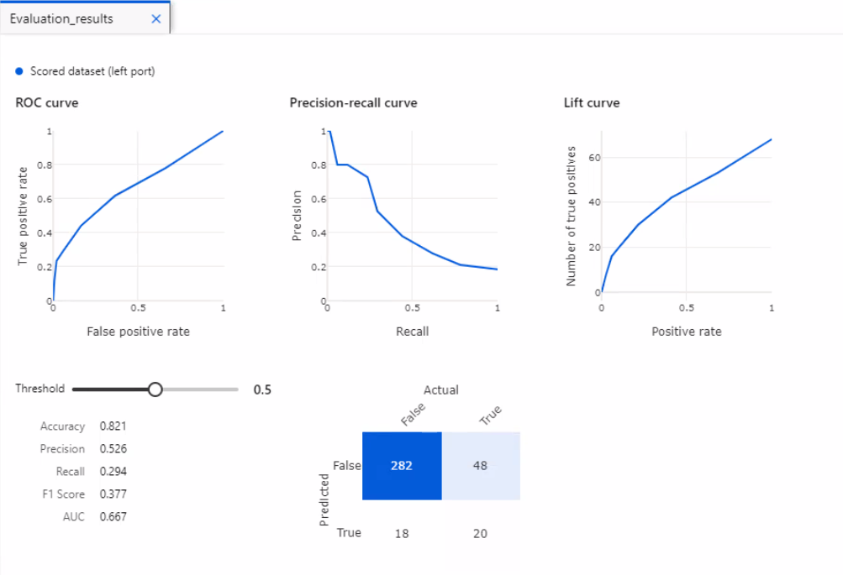
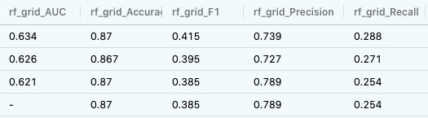
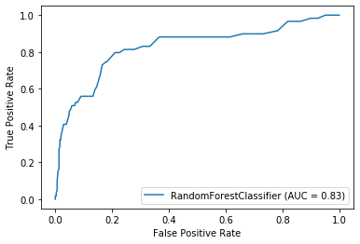
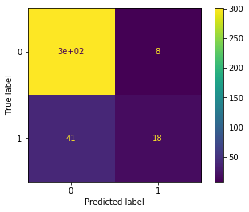
Testing

Slide 15
Deployment Services
Azure Container Apps
Ability of deploying containerized apps without managing complex infrastructure
Flexibility of using different programming languages
MLflow
Using mlflow.deployments module
Deploying to AWS Sagemaker: mlflow.sagemaker module
Deploying to AzureML: mlflow.azureml module

Slide 16
Model Monitoring
Model Monitoring: The process of closely tracking the performance of machine learning models in production.
Azure:
Ability of data drift
No need to code

Slide 17
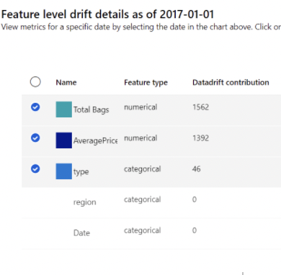
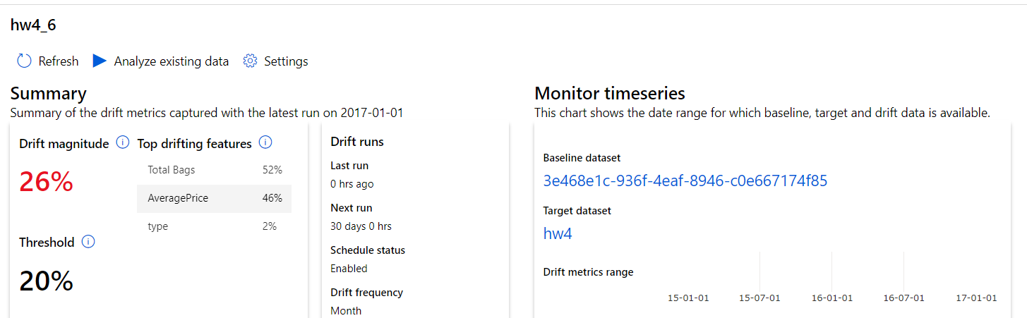
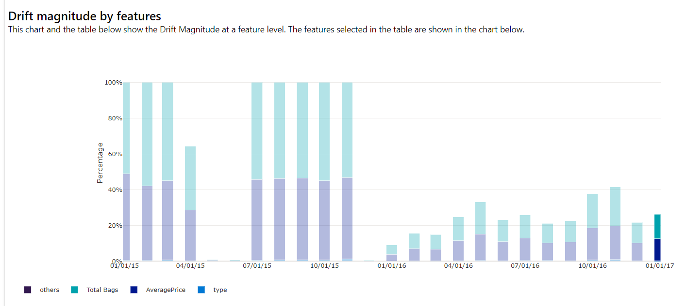
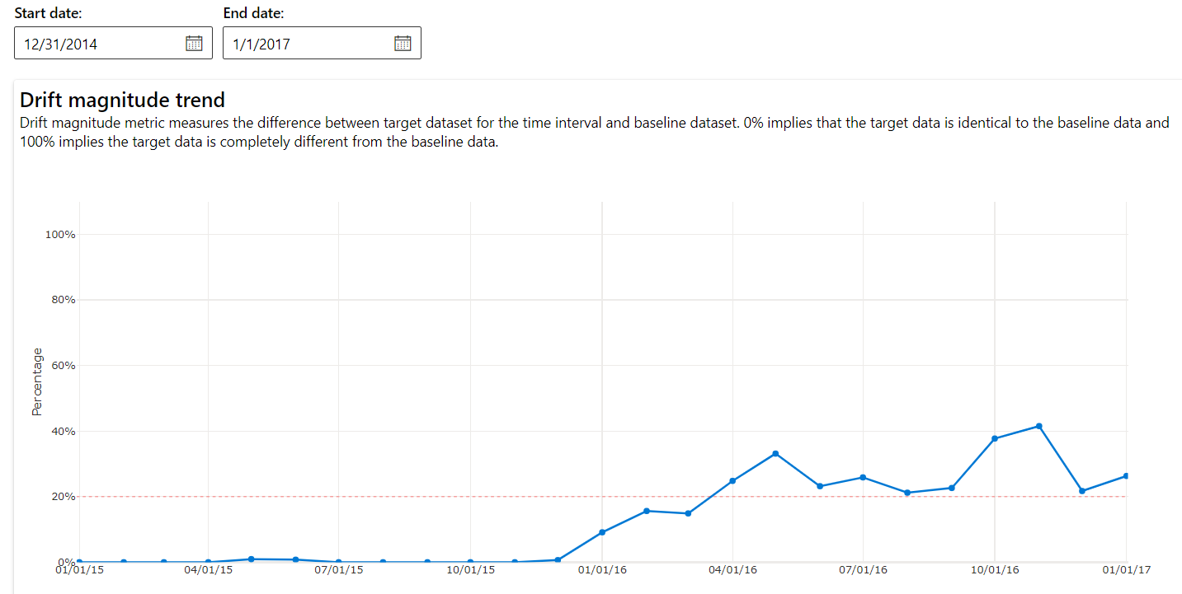
Model Monitoring
1 3
2 4

Slide 18
Choice of Platform
Azure
Auto ML and Model monitoring
Able to run without code
Better UI design
Cheaper
More features and services

Slide 19
Challenges
Azure
Run slowly
Complex if writing code
Unable to detect model drift
Databricks
Unable to implement Auto ML and Model Monitoring
Must write code
Expensive

Slide 20
Future Improvements
Make running speed faster
Show estimated wait time
Make code easier
Able to detect model drift

Slide 21
Thank you!

